Slide 1

Namma Yatri Data Analysis
team
- AMRITA GHOSH, Aditya Mahajan, Anindya das

Slide 2
Introduction
Namma Yatri is dedicated to providing an efficient and reliable transport service across various Indian cities. By utilizing this dashboard, stakeholders can ensure that the service is continuously optimized to meet user expectations and operational goals.
Namma Yatri plays a pivotal role in Bengaluru’s urban transport network. With its dynamic operational environment, the company must adapt to evolving demand patterns, optimise ride allocations, and ensure profitability while enhancing customer experience.
Customer friendly app Namma Yatri is a mobility application built with a vision to effectively contribute to the Open Mobility initiative.

Slide 3
Executive Summary
Project Overview:
Analysis of Namma Yatri data to derive actionable insights.
Focus on improving operational efficiency and marketing strategies.
Data-driven recommendations for business growth.
Key Objective: Understand user behavior, ride performance, and revenue drivers
Tools: Power BI, Data Modelling, Visualization
Outcome: Actionable insights and strategy suggestions.

Slide 4
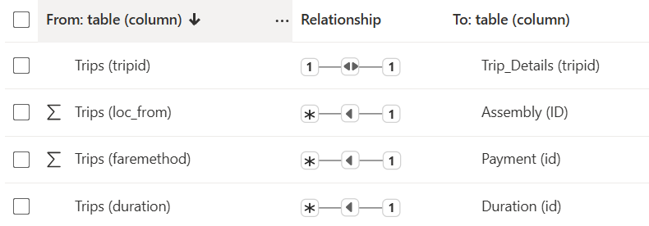
Business Context & Problem Statement
Rising ride demand but inconsistent performance
Need for data-backed operational and marketing insights
Imported and joined multiple tables in Tableau/Power BI.
Ensured data accuracy by resolving inconsistencies.
Created calculated fields for relevant analysis

Slide 5
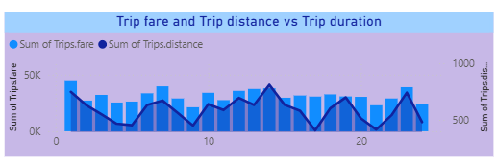
Exploratory Data Analysis: Ride Demand
Analyzing Ride Demand Over Time.
Identified peak demand periods: During commute hours 9AM-2PM (commute to work) and 7PM-12AM (commute to home).
Lower demand during early morning and late-night hours.
Summary of tables: Trips, Trip Details, Assembly, Duration, Payment

Slide 6
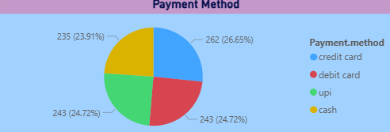
Payment Method Analysis
Credit card is the most frequently used payment method.
Digital mode of payment is more preferred.
Cash mode of payment is least preferred.

Slide 7
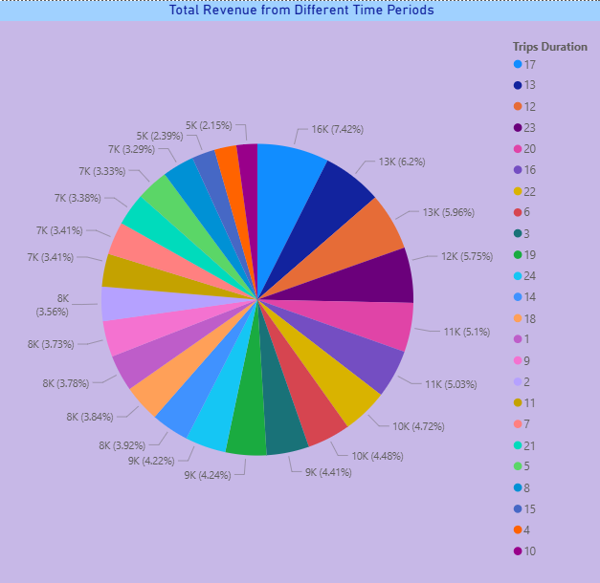
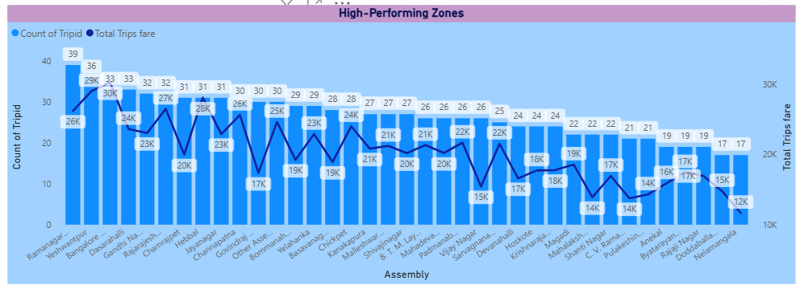
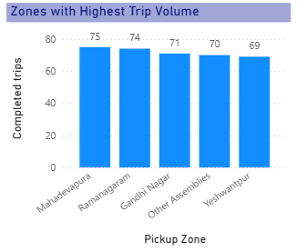
Trip Trends Across Zones
Ramanagaram has the highest number of trip requests (39)
Bangalore South generates the highest revenue (30295) followed by Yeshwantpur (29035)
Mahadevapura, Ramanagaram , Gandhi Nagar, Other Assemblies and Yeshwantpur are the top five pickup zones with the highest number of completed trips.
At 5pm total trip fare collected is maximum amount of Rs 15921 which is 7.42% of total revenue followed by 1pm.

Slide 8
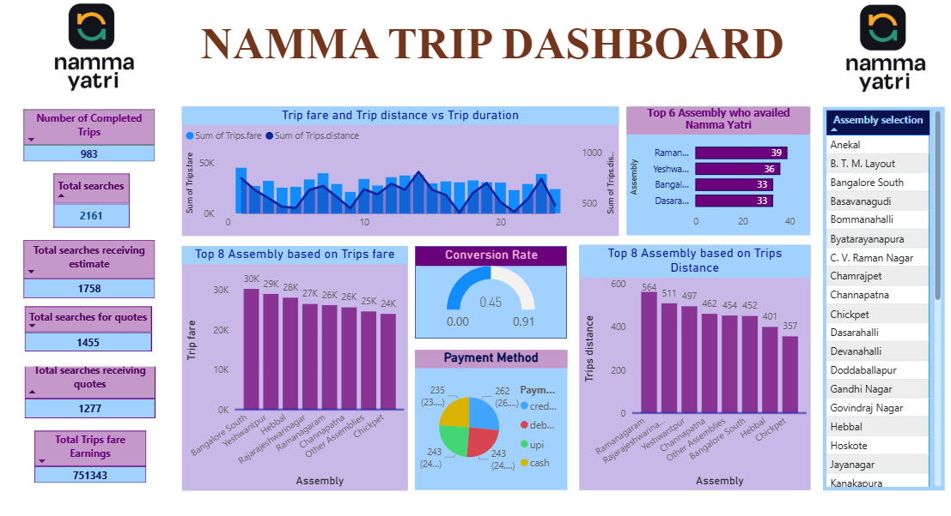
Namma Yatri Dashboard using Power BI

Slide 9
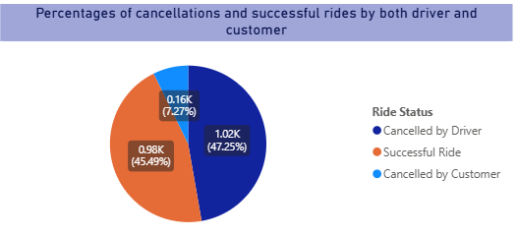
Analysis of Cancellations and Successful Rides
Cancelled by Driver: 47.25% , Cancelled by Customer: 7.27% , Successful Ride: 45.49%.

Slide 10
Strategic Recommendations
Promote the quote search feature.
Incentivize completion and improve communication.
Implement cancellation reason tracking and penalties.
Focus on high-cancellation locations and predictive alerts.

Slide 11
Thank You *incase of any query/concern contact us via email
Q&A

